Slide 1
CNN–based Prediction of Boiling Heat Transfer
Yash Trivedi (yash.trivedi@okstate.edu)

Slide 2
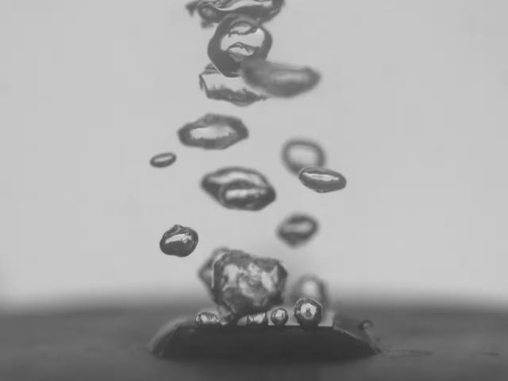
Introduction to Boiling
Heat transfer is a limiting design factor in many high-energy systems
Typical cooling strategies include forcing air/liquid over a heat source
Convective heat transfer can carry energy away from heat sources
Much more effective to boil a cooling fluid and take advantage of latent heat
10-100x better heat transfer

Slide 3
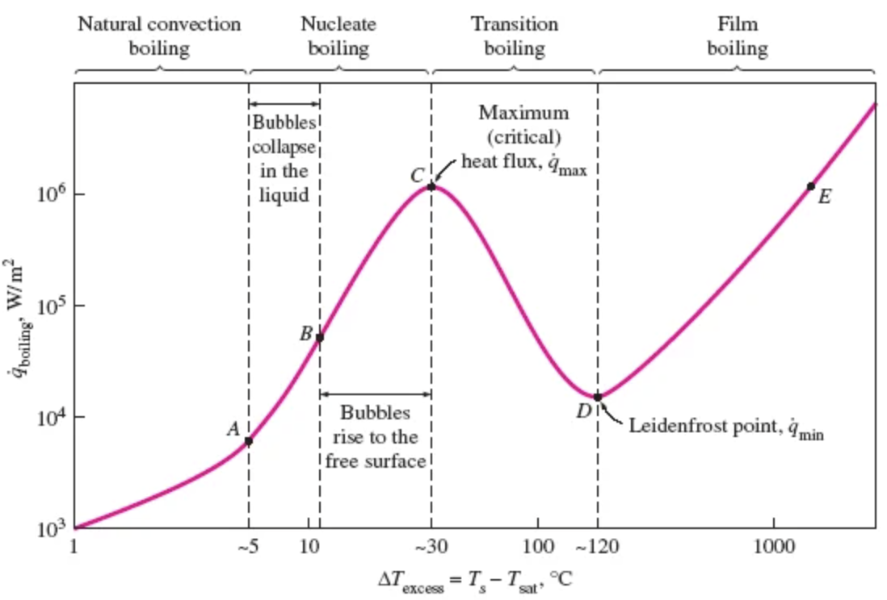
Introduction to Boiling
Plot of boiling heat transfer
Y-axis is heat transfer
X-axis is temperature difference between fluid and surface
Boiling takes place in different “regimes” based off conditions
Early regimes are more stable and safer to operate in, but relatively low heat transfer
Late regimes offer much higher heat transfer, but very unstable and unpredictable
Good
Bad

Slide 4

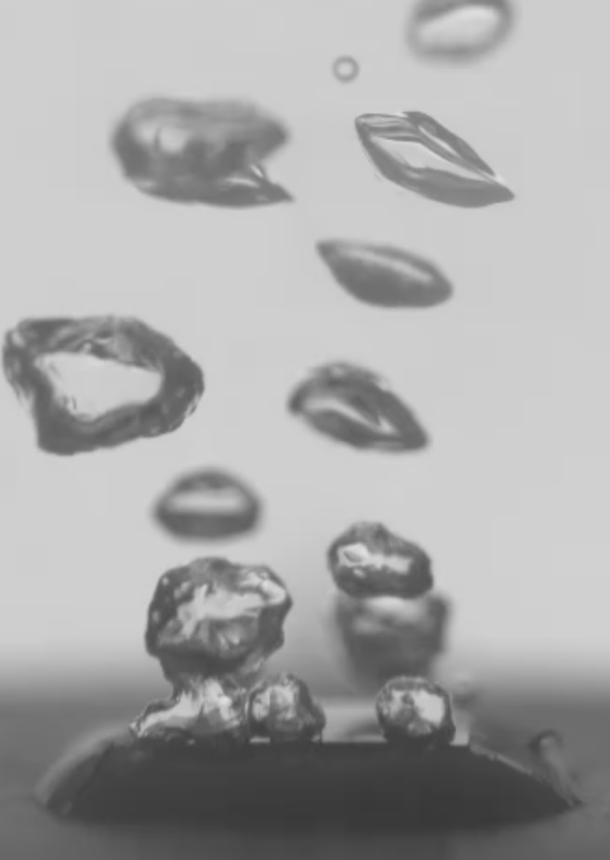
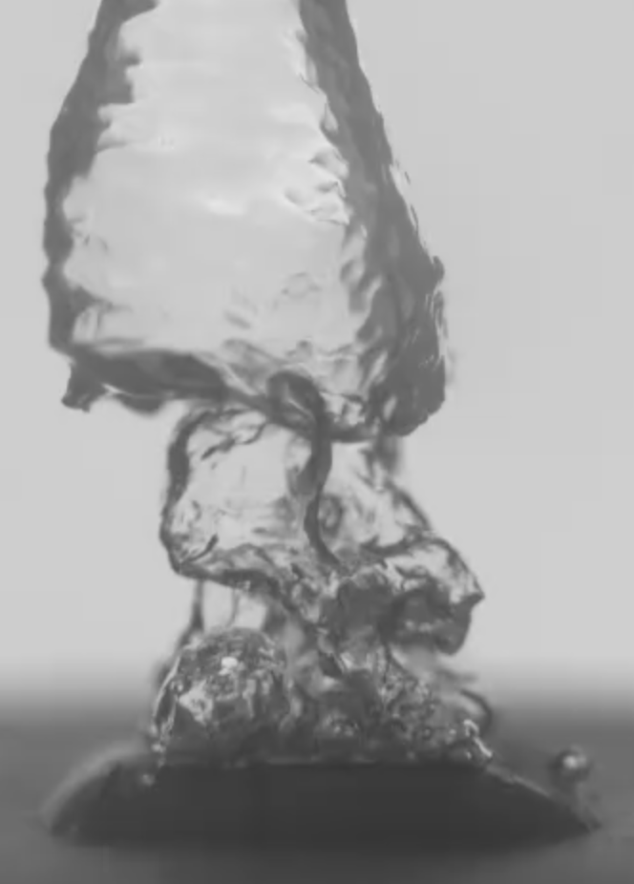
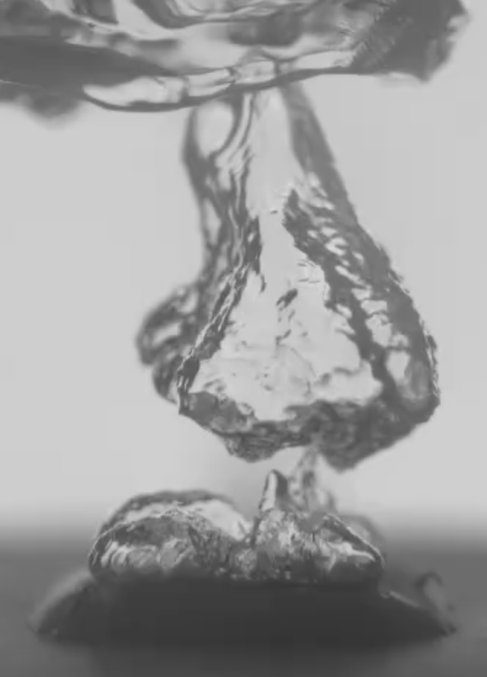
Introduction to Boiling
Natural Convection
Boiling
Early Nucleate
Boiling
Late Nucleate
Boiling
Near CHF
Boiling

Slide 5
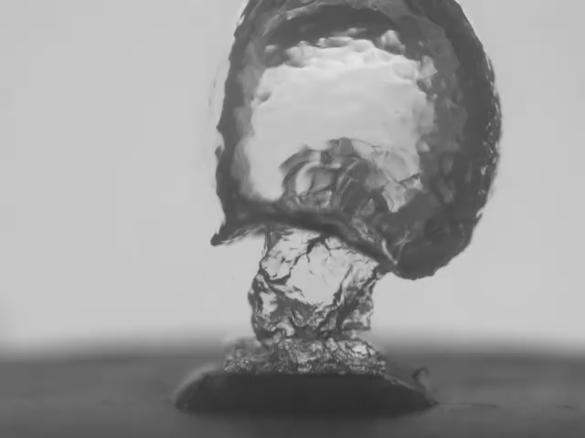
Introduction to Boiling
Video shows unstable bubble growth and departure as boiling approaches critical heat flux
Visually different to early boiling regimes
Visual differences open opportunities to use CNNs

Slide 6
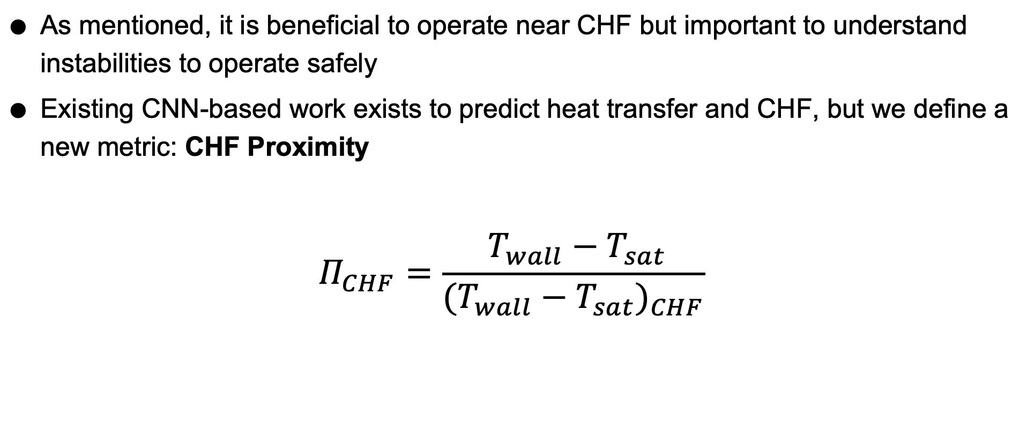
Target Metric for CNN
As mentioned, it is beneficial to operate near CHF but important to understand instabilities to operate safely
Existing CNN-based work exists to predict heat transfer and CHF, but we define a new metric: CHF Proximity
$$Π_{CHF}=\frac{ T_{wall}−T_{sat}}{{(T_{wall}−T_{sat})}_{CHF}}$$

Slide 7
About the dataset
Data from: “Unveiling hysteresis of transient boiling: A multimodal perspective”
Published by Pandey et. al, in 2025
Study to understand how boiling is different when ramping up and down in power using visual, audio, and temperature data
Produced and published two full videos of boiling ramping up to CHF and back down, along with all temperature data
Boiling_84: Deionized water on a copper foam surface
Boiling_91: Deionized water on a smooth copper surface

Slide 8
Data Processing
Needed to create dataset of images and temperature points that are lined up
Boiling_84: 45 minutes at 60fps, 1.5 million temperature points
Boiling_91: 32 minutes at 60 fps, 1 million temperature points
Original dataset was far too data dense, so down-sampling was done
Python script created to chop up raw data and created linked image frame at every temperature point
Resulting in 1200 data points from each set from zero boiling up to CHF
One set for training, one set for testing

Slide 9
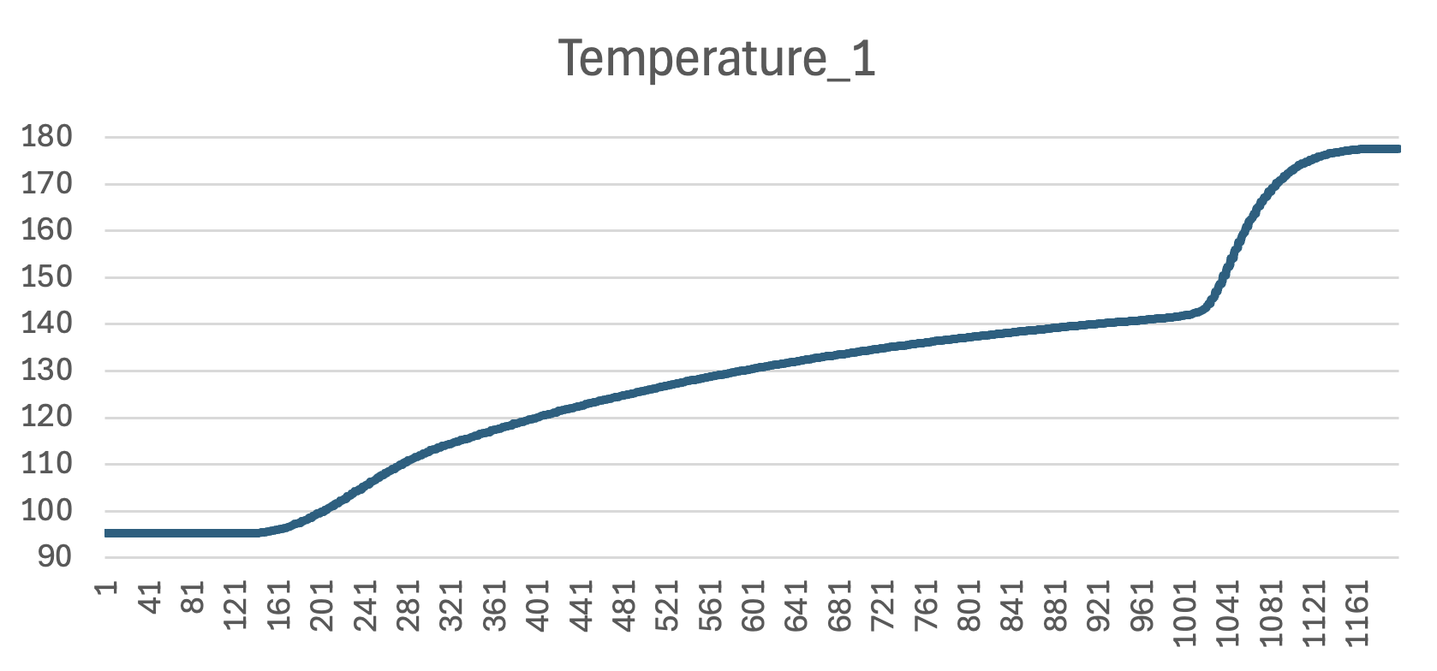
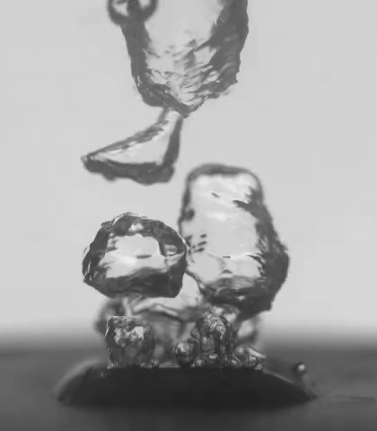
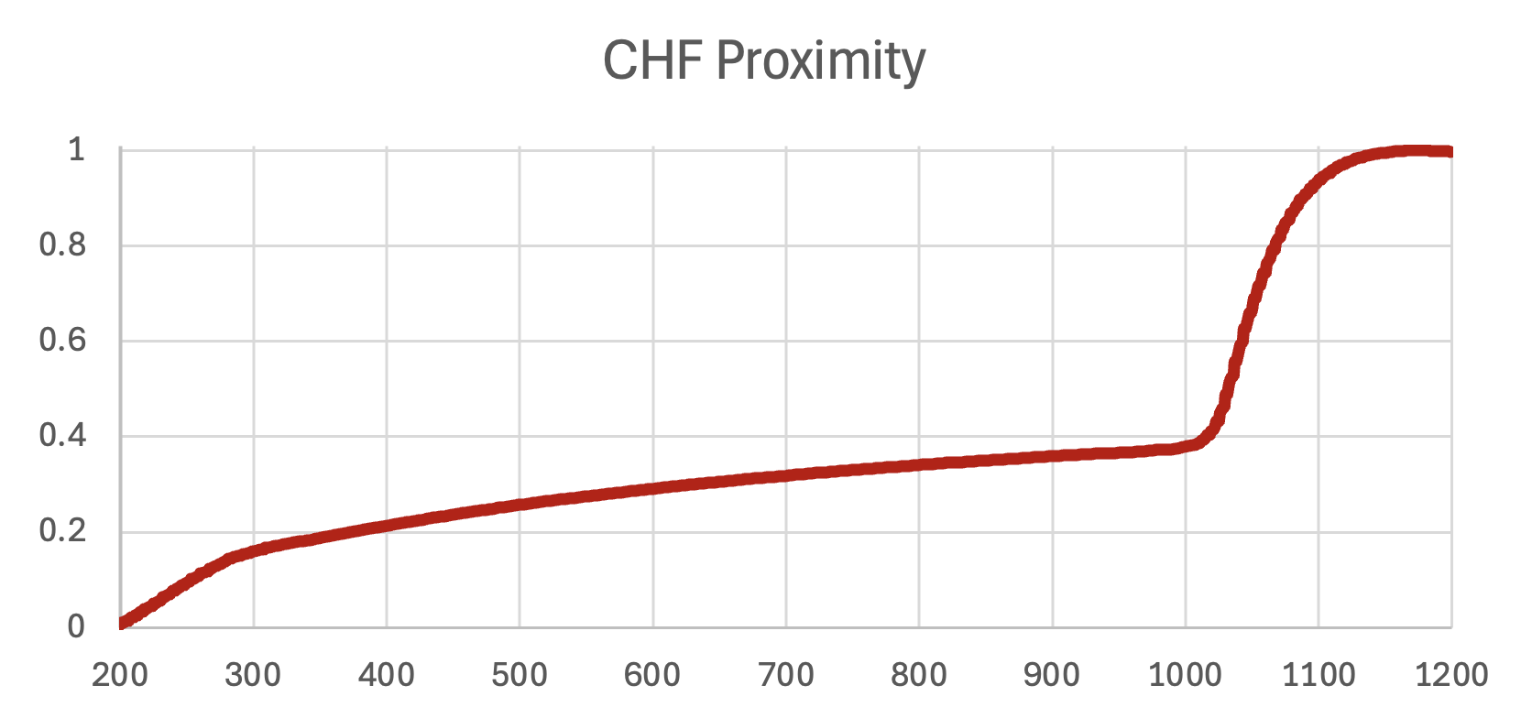
Data Processing

Slide 10
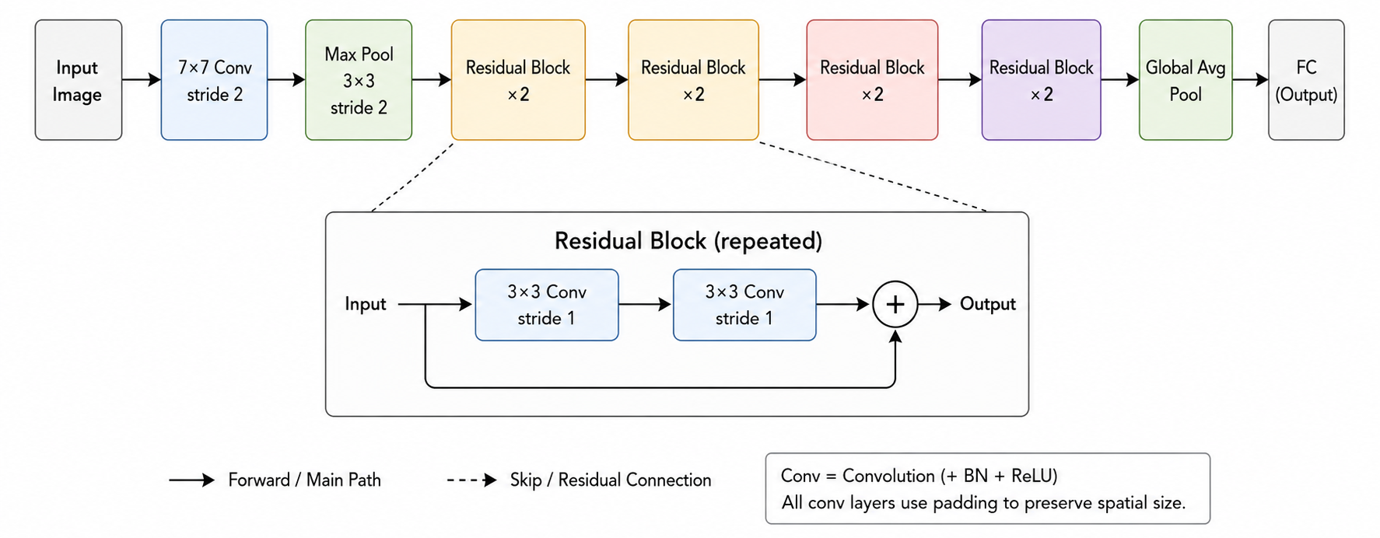
CNN Network Choice
Decided to go with ResNet-18 (reasoning shown in next slides)

Slide 11
CNN Network Choice
Dataset is relatively small, likely insufficient to train a custom model
Chose to use a pretrained model, perform training on pretrained weights
AlexNet
ResNet
InceptionNet
Etc.
CNN Architecture | Model F1 Score
Basic CNN | 91.11%
AlexNet | 98.87%
ResNet | 96.50%
InceptionNet | 94.23%
Classification of boiling regimes, fluids, and heating surfaces through deep learning algorithms and image analysis
Published by Paz et. al, in 2025

Slide 12
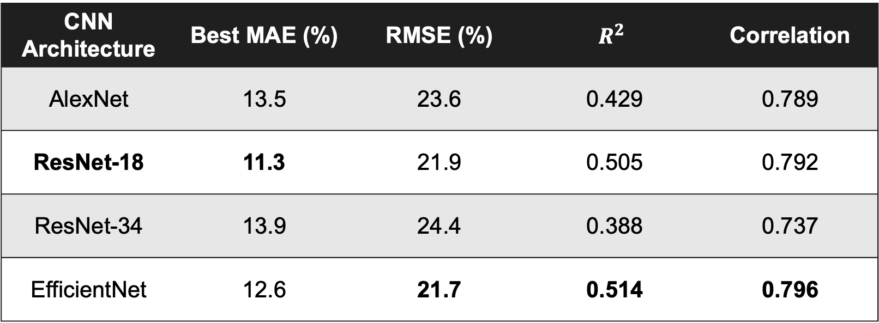
Testing different networks
Results of my own network experimentation:
CNN Architecture | Best MAE (%) | RMSE (%) | $$R^{2}$$ | Correlation
AlexNet | 13.5 | 23.6 | 0.429 | 0.789
ResNet-18 | 11.3 | 21.9 | 0.505 | 0.792
ResNet-34 | 13.9 | 24.4 | 0.388 | 0.737
EfficientNet | 12.6 | 21.7 | 0.514 | 0.796

Slide 13
Tuning ResNet-18 Model
Different ways I tried to improve the model:
Training Hyperparameter Tuning:
Batch size optimal at 32
Learning rate best at 1e-4
Weight Decay at 1e-4
Backbone not frozen during training
Data Augmentation
Color Jitter made very small improvement
Random scaling and translation made larger impact
Output layer dropout
Dropout = 0.2 was beneficial, 0.4 was too much
14.7% MAE
11.3% MAE

Slide 14
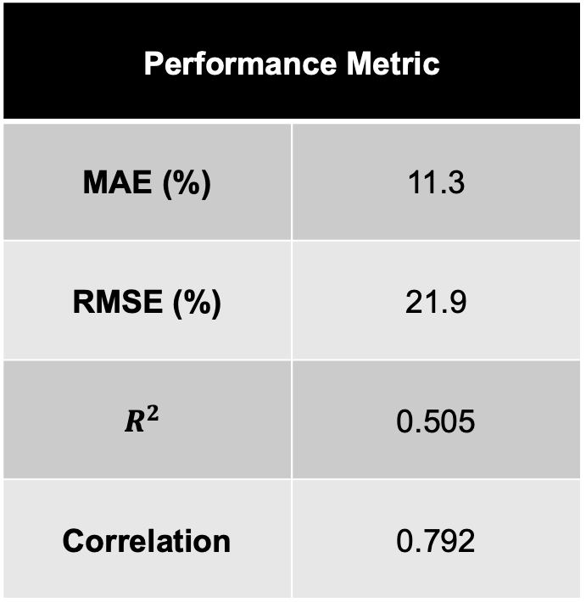
Final Model and Results
Final Model:
ResNet-18 with Sequential Output Layer
One feedforward layer
Dropout: 0.2
Epochs: 10
Learning Rate: 1e-4
Weight Decay: 1e-4
Validation Split: 0.2
Performance Metric
MAE (%) | 11.3
RMSE (%) | 21.9
$$R^{2}$$ | 0.505
Correlation | 0.792

Slide 15
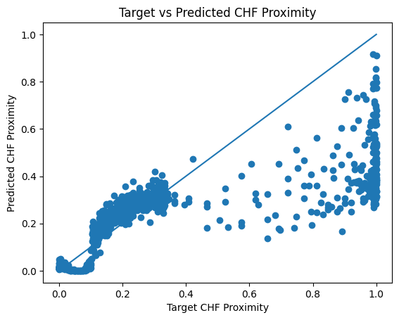
Final Model and Results
Target vs Predicted for ResNet-18
Shows very strong prediction for targets between 0.1 to 0.4
Very poor performance above 0.5 due to lack of data

Slide 16
Conclusions and Future Work
ResNet-18 outperformed other tested networks
Hyperparameters tuned to optimize performance
Data augmentation improved generalization
Dropout improves generalization
Shortage of training data
Model was bound to struggle with 50/50 train/test split
Need to account for data imbalance
Investigate dynamic CNN models
Leverage time series stream of images

Slide 17
References
He, K., Zhang, X., Ren, S., & Sun, J. (2015). Deep Residual Learning for Image Recognition (arXiv:1512.03385). arXiv. https://doi.org/10.48550/arXiv.1512.03385
Pandey, H., Li, C., Dunlap, C., & Hu, H. (2025a). Data from: Unveiling hysteresis of transient boiling: A multimodal perspective [Dataset]. Dryad. https://doi.org/10.5061/dryad.ksn02v7h2
Pandey, H., Li, C., Dunlap, C., & Hu, H. (2025b). Unveiling hysteresis of transient boiling: A multimodal perspective. Applied Thermal Engineering, 262, 125259. https://doi.org/10.1016/j.applthermaleng.2024.125259
Paz, C., Cabarcos, A., Concheiro, M., & Conde-Fontenla, M. (2025). Classification of boiling regimes, fluids, and heating surfaces through deep learning algorithms and image analysis. International Journal of Heat and Mass Transfer, 242, 126829. https://doi.org/10.1016/j.ijheatmasstransfer.2025.126829

Slide 18
Thank you for listening!

